Slide 1
Spam Classification using Machine Learning
Authors – Aishwarya Varala and Chaithanya Pramodh Kasula
Course Number and Name - AIT-614, Big Data Essentials
Course Professor’s Name – Dr. Liao DuoDuo
University Name – George Mason University
Date – 6th May, 2020

Slide 2
INTRODUCTION
Spam emails constitute 45% email traffic.
It becomes important to classify them into spam or not spam by using Machine Learning/AI
OBJECTIVE
Learn how data can be directed to the Machine Learning model using data engineering.
Applying Kafka to stream data from Producer to Consumer.
Integrating Kafka with analytics program .
Using visualization software to Effectively convey analysis and results
LITERATURE SURVEY
Algorithms that were used before on Spambase data set include
Random Forest Classification
Naïve Bayes Classification
K* Classification Algorithm
Fuzzy SVM Classification
Our models include
Random Forest Classification
Support Vector Classification
Dimensionality Reduction and Support Vector Classification
Classification using Neural Networks
Ensemble Method

Slide 3
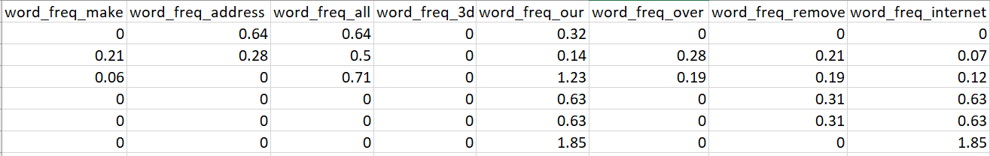
DATASET
The selected data set is ‘Spambase Data Set’, created by Hewlett-Packard Labs.
The data set has 4601 records.
It constitutes 57 continuous attributes and one nominal class label.
The label column determines if the email is spam (1) or not (0).
The data has
48 continuous real attributes of type word_freq_WORD,
6 continuous real attributes of type char_freq_CHAR,
1 continuous real attribute of type capital_run_length_average
1 continuous integer attribute of type capital_run_length_longest
1 continuous integer attribute of type capital_run_length_total

Slide 4
ARCHITECTURE
Data Preprocessing
Training and Testing with Machine Learning Models
Performance analysis and Visualization
Kafka
Input
Input
Data Source/CSV
Software and Hardware
Software: Kafka, Python, Tensorflow, Keras, Sklearn, Pandas, Numpy, Matplotlib, Jupyter Lab, Anaconda.
Hardware: Intel Core i7 Processor, 8GB DDR4 RAM

Slide 5
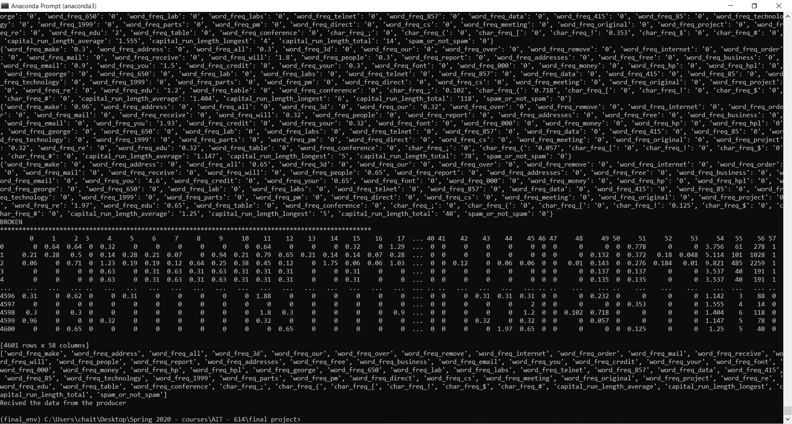
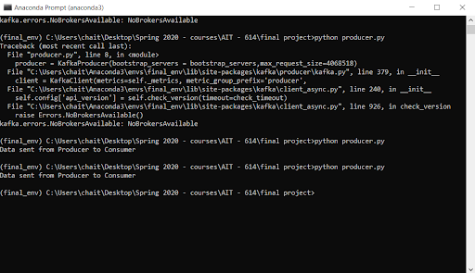
Kafka
Data is streamed from a CSV through Producer to Consumer
Consumer collects the data and invokes the analytics program over the collected data.

Slide 6
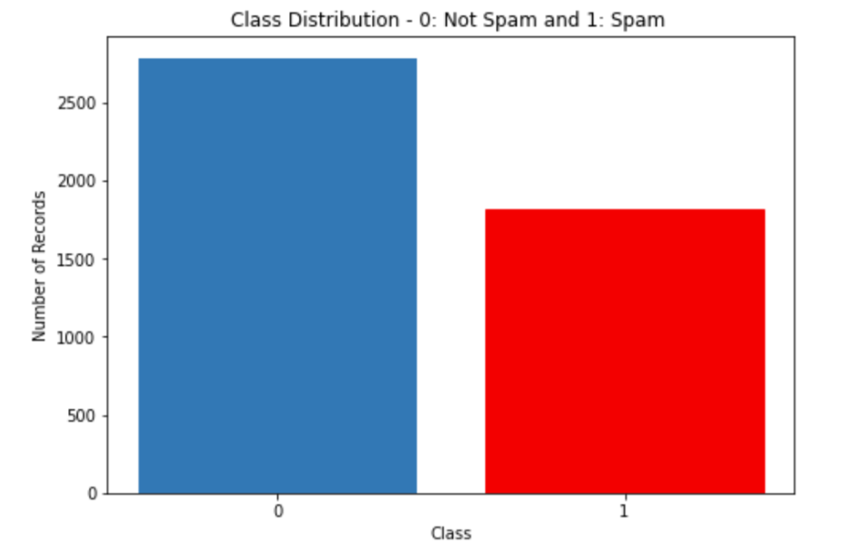
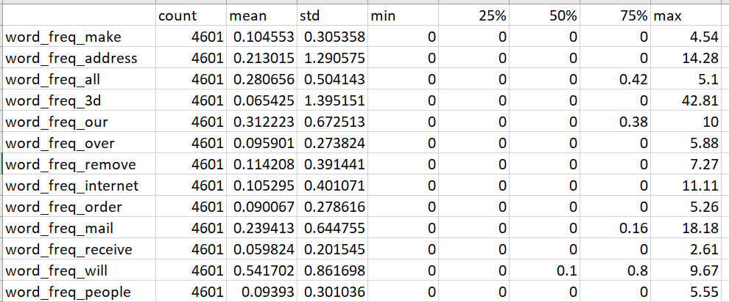
Class Distribution
The dataset has 1813 spam instances that is 39.4% of the data
It has 2788 non-spam instances that make 60.6% of the entire data set.
Descriptive Statistics
The feature capital_run_length_total has the highest mean and standard deviation of 283.28 and 606.34 respectively.
The data was tested, and it was confirmed that there are no null values.
Descriptive Statistics

Slide 7
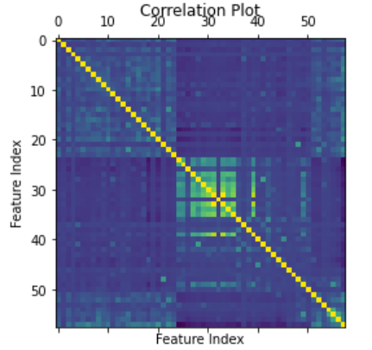
Data Types Inferential Statistics
The datatypes of all columns are float except for the columns capital_run_length_longest, capital_run_length_longest and spam_or_not_spam which have datatypes as int.
Chi square test of independence
Columns – word_freq_money and spam_or_not_spam
Null hypothesis- The feature and class are independent.
Alternate hypothesis- The feature and class are dependent.
The p-value obtained is less than 0.05. Hence, we reject null hypothesis and accept alternate hypothesis.
The same test has been performed for word_freq_technology and spam_or_not_spam.
Normalization
The data has been normalized by column such that the highest and lowest are mapped to [0,1].
Correlation Plot
Features whose Pearson’s correlation coefficient value exceeding 0.845(highly correlated) have been removed from the data set as they do not add any additional value.

Slide 8

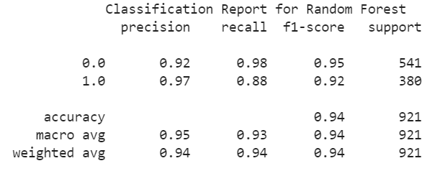
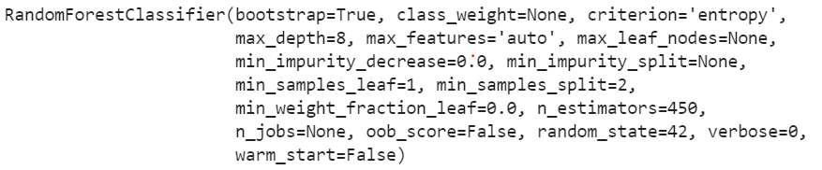
Random Forest
Cross validation metrics Test scores
Model and Hyperparameters

Slide 9

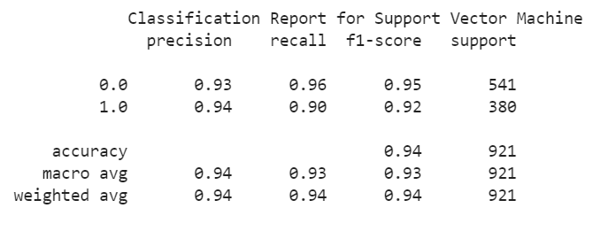
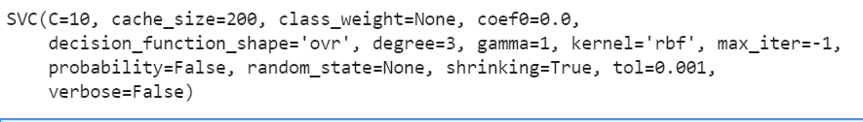
Support Vector Machine
Cross validation metrics Test scores
Model and Hyperparameters

Slide 10
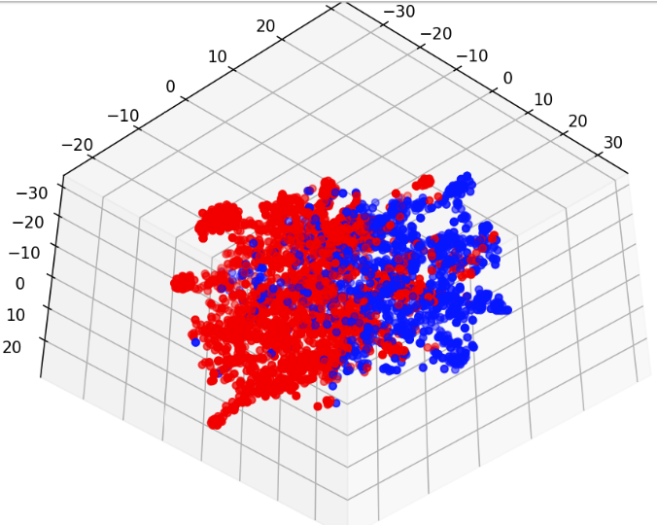
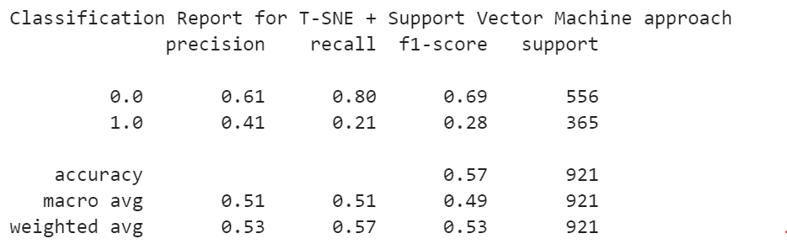
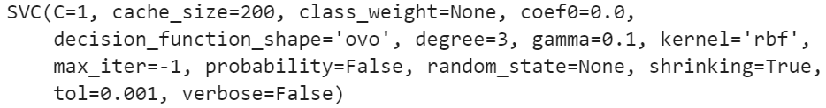
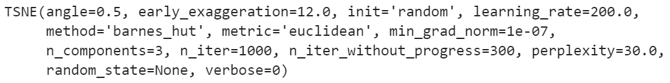
T-SNE(Dimensionality Reduction) + Support Vector Machine
Model and Hyperparameters
Visualization of data points in lower dimensions using T-SNE
Test Scores
Dimension 1
Dimension 2
Dimension 3

Slide 11
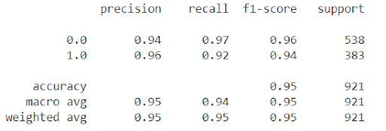
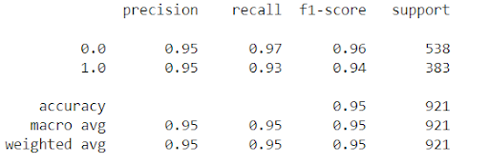
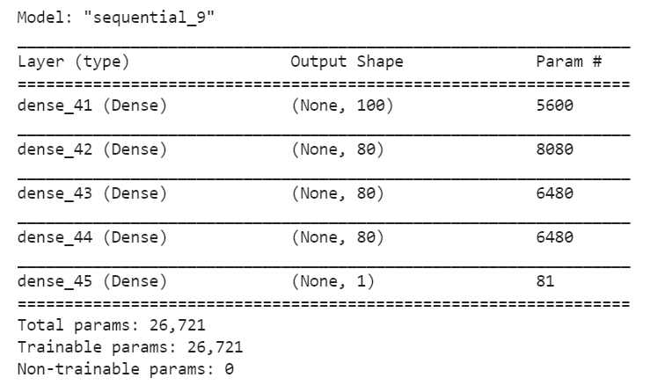
Ensemble Neural Network
Test Scores Test Scores
Results Summary and Analysis
Model Summary
 | Precision |  | Recall |  | F1-Score |  | Support
 | 0 | 1 | 0 | 1 | 0 | 1 | 0 | 1
Random Forest | 0.92 | 0.97 | 0.98 | 0.88 | 0.95 | 0.92 | 541 | 380
SVM | 0.93 | 0.94 | 0.96 | 0.90 | 0.95 | 0.92 | 541 | 380
SVM+T-SNE | 0.61 | 0.41 | 0.80 | 0.21 | 0.69 | 0.28 | 556 | 365
Neural Network | 0.95 | 0.95 | 0.97 | 0.93 | 0.96 | 0.94 | 538 | 383
Ensemble | 0.94 | 0.96 | 0.97 | 0.92 | 0.96 | 0.94 | 538 | 383
Thank You

